Slide 1

RAJAMAHENDRI INSTITUTE OF ENGINEERING AND TECCHNOLOGY
ELECTRONICS AND COMMUNICATION ENGINEERING
Under the Guidance of
Dr. CH. SURYABABU,
M.Tech, Ph.D.
PRESENTED BY: J. DHEERAJ 21MD1A0429
G. BHARATH CHANDU 21MD1A0422
N. SATISH CHANDRA 22MD5A0407
M. JAGADIESHESWAR 21MD1A0440

Slide 2
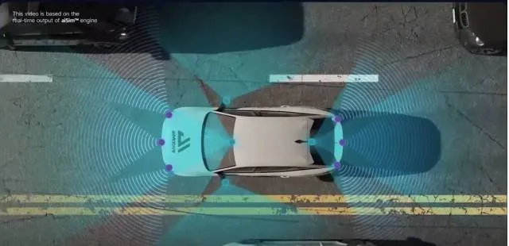
TITLE
Mean Based Approach To Omnidirectional Pathfinding Algorithm Using Single Ultrasonic Sensor for Robotic Car

Slide 3
Contents
Abstract
Introduction
Problem statement & challenges
System components
Working mechanism
Block diagram
Sensors used
Existing methods & limitations
Proposed method
Advantages and future scope

Slide 4
Abstract
We propose an IoT-enabled omnidirectional pathfinding system to improve real-time obstacle detection and navigation for autonomous robotic vehicles. By integrating a single ultrasonic sensor, a servo motor, L293D motor driver, and IoT-based monitoring, our system scans a 180-degree field for better detection and accuracy. Processed data from the sensor allows smooth navigation via a mean-based pathfinding algorithm. This system reduces false positives, optimizes movement, and enables remote monitoring, ideal for applications like search-and-rescue, industrial automation, and hazardous environment exploration.

Slide 5
Introduction
-54564654

